Slide 1

E-Portfolio about the GODOT Engine
An introduction to the Engine and it‘s own scripting language.

Slide 2
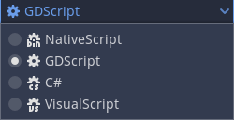
About GODOT
developed since 2007
open-source game development engine
two diffrent versions:
Standard
Mono
4 diffrent scripting languages
build-in syntax highlighting
heavy in development

Slide 3
Diffrent versions?
splitted in mono/standard
about 30 releases
current version 3.3

Slide 4
Download possibilities
all releases:
https://downloads.tuxfamily.org/godotengine/
homepage:
https://godotengine.org/download
others:
https://store.steampowered.com/app/404790/Godot_Engine/
https://godotengine.itch.io/godot
https://github.com/godotengine/godot/releases

Slide 5
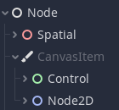
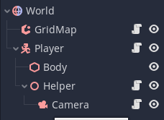
High modifiability and abstraction
open-source allows to create plugins
Intehritance of abstract classes
tree like structure

Slide 6
GDScript a short introduction

Slide 7
What is GDScript
high-level, dynamically typed
similiar to python
easy to learn
specifically made for GODOT

Slide 8
Language Features
build in documentation
inheritance from engine defined types
onready keyword for intialisation during preparation
Signals to interact between nodes

Slide 9
Demonstration time ☺

Slide 10
Thank you for your attention!

Slide 11
Sources
website:
https://godotengine.org
full documentation:
https://docs.godotengine.org/en/stable/
https://docs.godotengine.org/en/latest/
git repository:
https://github.com/DSinMeliodas/DHBW-SE-Presentation-Godot

